Slide 1
Dynamic Programming

Slide 2
Time-Space Tradeoffs
Gaining Time:
Input Enhancement: save time by preprocessing input
Prestructuring: Use extra space to facilitate more flexible access.
Dynamic Programming
Gaining Space:
Compression Algorithms

Slide 3
Dynamic Programming
Technique for solving problems with overlapping subproblems.
Store subproblem solutions, save recomputing.
Create table of subproblem solutions (often all).
“Programming” doesn’t refer to coding
Technique came from mathematics
Problems involving multi-stage planning
“Programming” meant “planning”

Slide 4
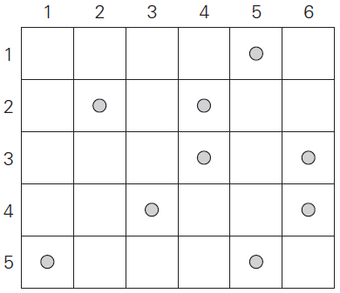
Coin Collecting Problem
Several coins are placed on an n x m board, no more than one coin per cell. A robot located in the top-left corner can only move one cell down or one cell right at a time. What is the maximum number of coins the robot can pick up en route to bottom-right cell?
Can you define F(i,j), the maximum number of coins robot can bring to ith row and jth column of board?

Slide 5
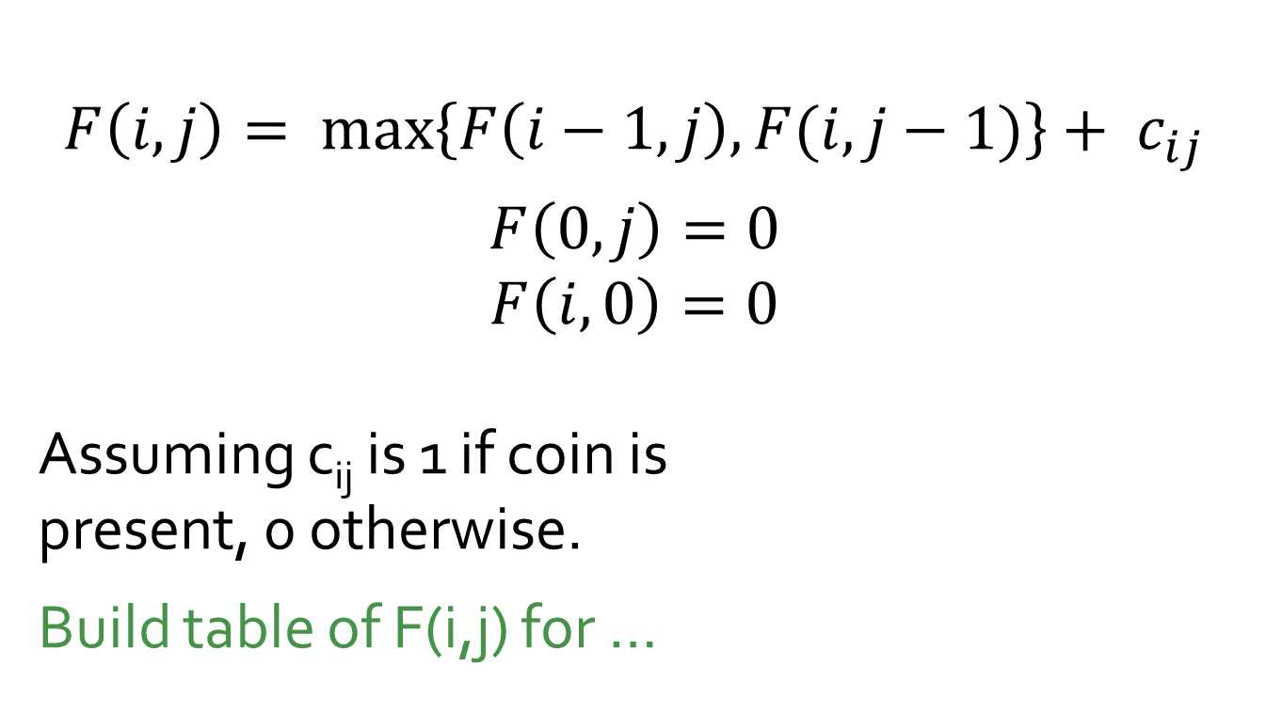
Coin Collecting Problem
$$F\left(i,j\right)= \max_{}\left\{F\left(i−1,j\right), F(i,j−1)\right\}+ c_{ij}$$
$$F\left(0,j\right)=0$$
$$F\left(i,0\right)=0$$
Assuming c_{ij} is 1 if coin is present, 0 otherwise.
Build table of F(i,j) for …

Slide 6
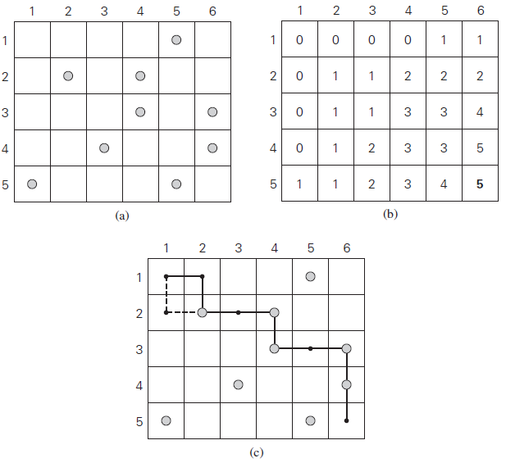
Solution to Example Problem

Slide 7
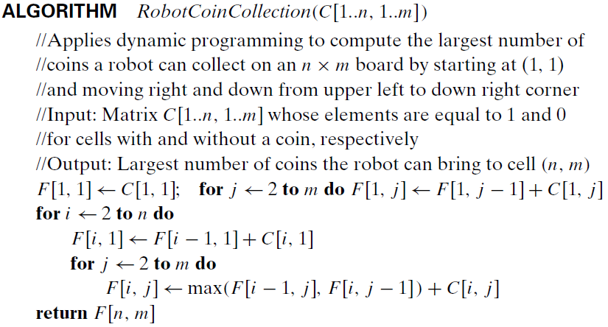
Coin Collecting: Θ(n ∙ m)

